Slide 1


Data WH Mining Term Project
Team 6:
Benjamin Huus
Raja Yeswanth Nalamati
Sreenilaya Cherukumalli
Notes:
Hello everyone, my name is Benjamin Huus, and today our team will be going over our Data Warehouse and mining term project

Slide 2

Data Warehousing using Star/Snowflake Schemas
Star Schema
Star Schema Advantages/Disadvantages
Star Schema Example
Snowflake Schema
Snowflake Schema Advantages/Disadvantages
Snowflake Schema Example
Star Implementation
Snowflake Implementation
Conclusion
Notes:
For this project, we chose to discuss the differences of data warehousing using star and snowflake schemas. On this slide you can see a list of topics we will cover.

Slide 3

Star Schema
Database Schema
Fact table
Dimension tables
OLAP optimization
Denormalized
Notes:
A star schema is a type of database schema that is optimized for data warehousing and online analytical processing (OLAP) applications. It is called a start schema because its structure resembles that of a star, with a central fact table connected to several dimensional tables. The star schema is designed to simplify querying and improve the performance of complex queries by organizing data in a way that makes it easy to understand and navigate.
The fact table is the central table in the star schema. It contains data related to the business process being evaluated. Each row in the fact table typically represents a unique event or transaction. Common attributes in the fact table include numeric values such as sales amount, quantity sold, and revenue. The table also contains foreign keys that reference primary keys in the dimension tables, establishing relationships between the fact table and the dimension tables.
Dimension tables surround the fact table and provide descriptive context to the facts. Each dimension table contains attributes that describe aspects of the business process, such as time, product, customer, or geography. Dimension tables are traditionally denormalized, meaning they store redundant data to make it easier and faster to perform queries. Each dimension table has a primary key that uniquely identifies each row, and these primary keys are used as foreign keys in the fact table.

Slide 4

Star Schema Advantages/Disadvantages
Denormalization
Fewer Table Joins
Easily understood
Optimized for OLAP
Notes:
There are many reasons why star schemas are effective for data warehousing. A star schema is fast for querying primarily due to its simplified structure, which is designed to optimize data retrieval and improve query performance. One key reason for the improved query performance is that the dimension tables are typically denormalized. This means that they store redundant data to minimize the number of joins required during queries. This reduces the complexity of queries and improves performance. Denormalized tables allow for fewer tables to be joined, which reduces the time needed to execute queries. A star schema is also a very straight forward data model. With a central fact table and surrounding dimension tables, this makes it easy for users to understand and navigate. However, there is a lower storage efficiency due to data redundancy.
There are clear relationships between the fact table and the dimension tables to simplify query construction, which leads to faster and more efficient query processing.
Star schemas are optimized to work for Online Analytical Processing (OLAP), which involves complex queries that aggregate and analyze large amounts of data. The schema’s structure supports efficient aggregation and summarization, which are common operations in OLAP queries.
Overall, the star schema’s design principles and optimization techniques contribute to its efficiency and speed in querying large datasets in data warehousing environments at the cost of additional storage requirements and complicated row inputs.

Slide 5
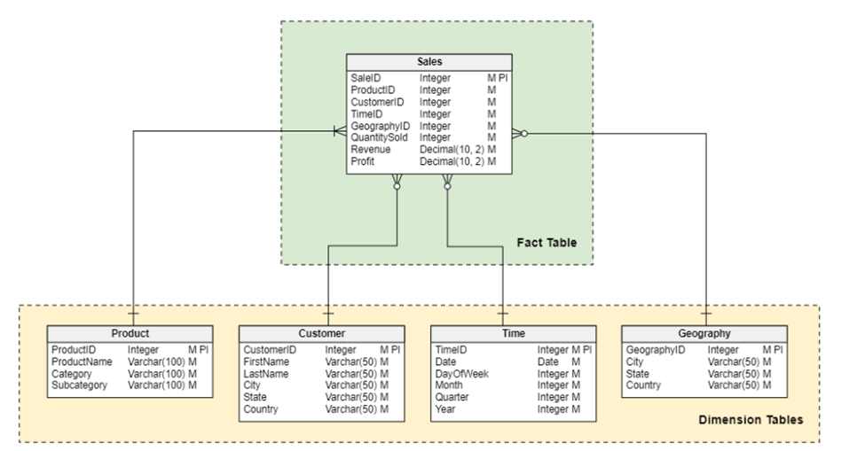
Star Schema Example
Notes:
In this example, each sales transaction is stored within the Sales table, which is being used as the fact table. You can see various foreign keys within the Sales table such as ProductID, CustomerID, TimeID, and GeographyID which are used to connect the dimension tables. The dimensional tables in this example are Product, Customer, Time and Geography.

Slide 6

Snowflake Schema
Database Schema
OLAP
Extension of Star
Normalized
Eliminates Data Redundancy
Notes:
A snowflake schema is a type of database schema used in data warehousing and and it’s also used in OLAP applications. It is an extension of the star schema where the dimension tables are normalized, splitting them into additional tables. This results in a structure that resembles a snowflake, with the fact table at the center connected to several normalized dimension tables. The normalization of dimension tables aims to reduce the data redundancy and improve data integrity.
Similar to the star schema, the fact table in a snowflake schema contains quantitative data related to business processes. The fact table includes foreign keys that reference primary keys in the dimension tables. The key difference between the star and snowflake schema is that in the snowflake schema, the dimension tables are normalized. These tables are decomposed into multiple related tables. The normalization process involves splitting the original dimension tables into smaller tables to eliminate redundancy and ensure data integrity.

Slide 7

Snowflake Schema Advantages/Disadvantages
Reduced Redundancy
Data Integrity
Storage Efficiency
Fewer anomalies
Scalable
Easier to Update
Notes:
The snowflake schema offers several advantages over the star schema, particularly in areas of data redundancy, integrity, and storage efficiency. The snowflake schema normalizes dimension tables, which means that data is stored in a more structured manner, reducing redundancy. Each piece of information is stored only once, which saves storage space and avoids the need for duplicate entries. By normalizing the dimensional tables, the snowflake schema ensures data consistency and integrity. Any updates to a piece of information are made in one place, reducing the risk of data anomalies and ensuring that all references to that data are consistent. Since the data is not duplicated, the snowflake schema can be more storage efficient. This can be particularly beneficial in large data warehouses where storage costs are a concern. Normalized tables make it easier to update and maintain the database. Changes to dimension attributes need to be made in only one place, reducing the effort required to keep the database current and accurate. A snowflake schema is more complex and hierarchical which can make it easier to organize and categorize data logically. The snowflake schema can be more scalable for very large databases with many dimensions and attributes.

Slide 8
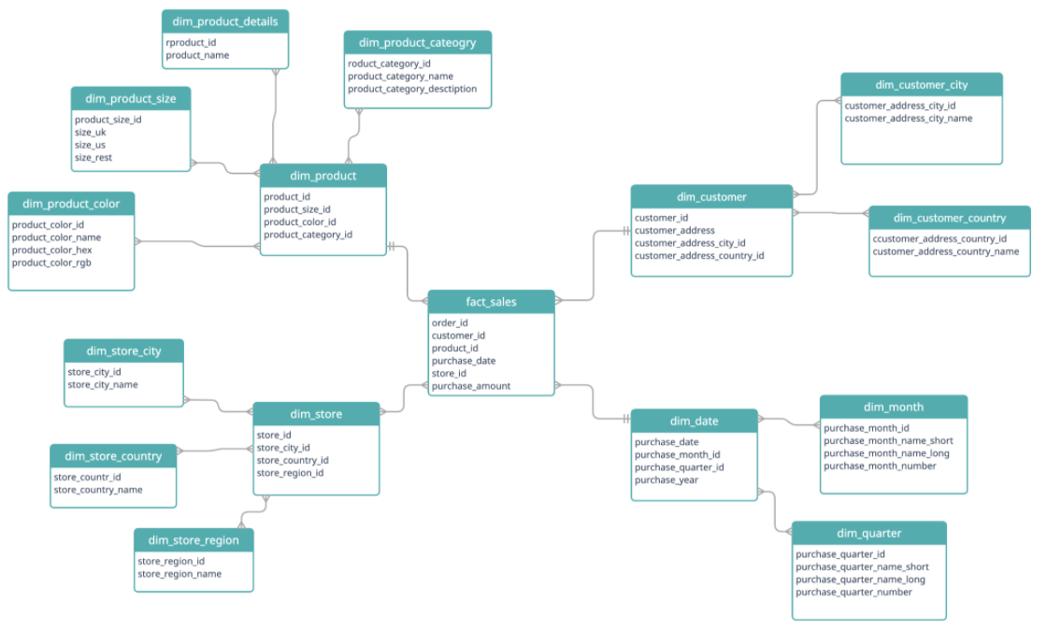
Snowflake Schema Example
Notes:
As you can see in this example of a snowflake schema, the fact table is again a Sales table, or the fact_sales. This then breaks into four dimensional tables: dim_product, dim_customer, dim_store, and dim_date. Each of these dimensional tables are connected to the fact table by foreign keys: product_id, customer_id, store_id, and purchase_date. Unlike the star schema, the dimensional tables are normalized. This means that each of the dimension tables are then broken down further into smaller dimensional tables. The resulting data model resembles a snowflake, hence the name.

Slide 9
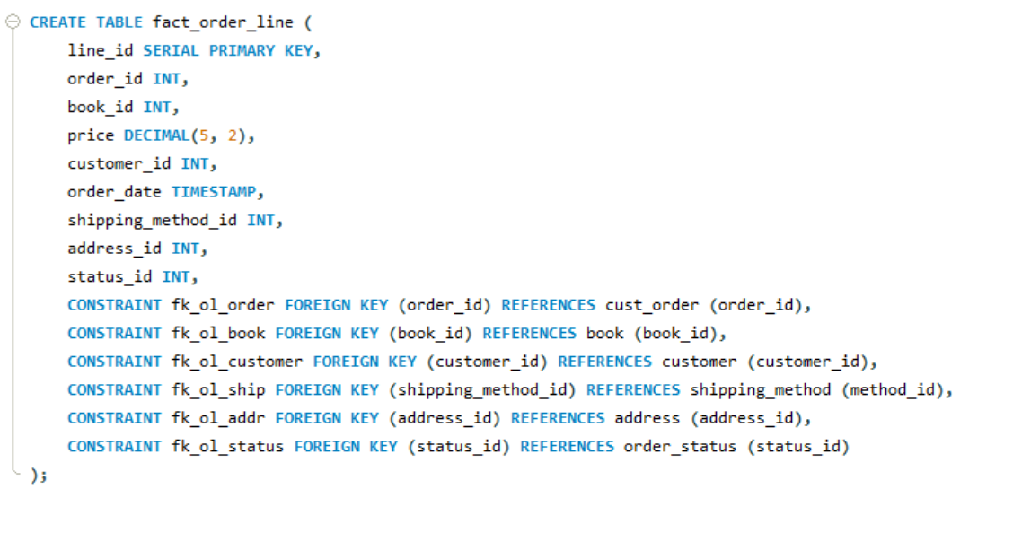
Snowflake Implementation – Fact Table
Notes:
For this project our team implemented a snowflake schema for a dataset of book sales for a fictional store called Gravity books. This dataset can be found using the links found in our report.
First we’ll look at the code used to generate the snowflake fact table, or the central table in the snowflake.
For this implementation, the fact table was: fact_order_line. The fact_order_line table consists of transactional information for the fictional bookstore Gravity Books. Some of the transactional information includes order_id, book_id, price, order_date, etc. Because it is a fact table, there are multiple foreign keys to connect the dimesion tables. These tier one dimensional tables are:
Cust_order – the customer orders dimensional table
Book – each of the book properties is located in this dimension table
Customer – Information for each customer is stored in this table
Shipping_method – shipping information
Address – Address information
Order_status – A simple normalized table that defines the status of orders

Slide 10
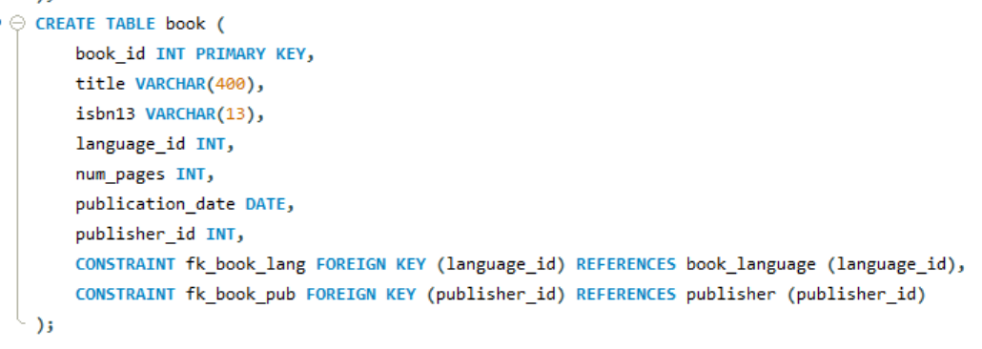
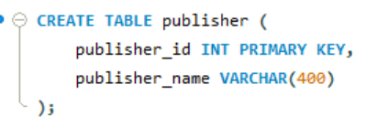
Snowflake Implementation – Dimension Tables
Notes:
Next, we have the dimensional tables. One example of a dimensional table is the Book table. This dimensional table holds information such as the book title, number of pages, publication date, etc. Because we are operating in the mindset of a snowflake schema, we’ll want to normalize this dimension table to help improve the storage efficiency. The book table is normalized by creating the deeper dimensional tables book_language and publisher. These tables are connected on the foreign keys language_id and publisher_id.
Finally, the leaf node dimension tables, book_language and publisher make our schema a snowflake.
For the entire code used to generate this schema, please see our github link.

Slide 11
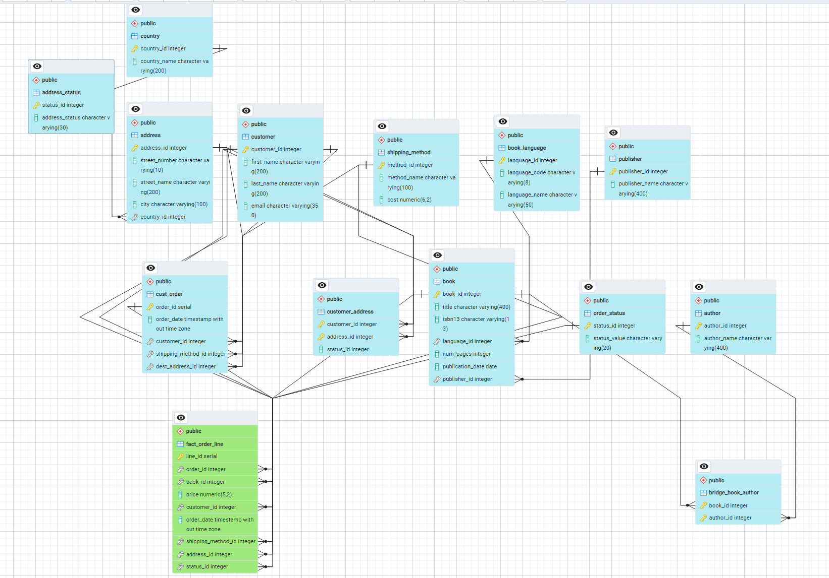
Snowflake ERD
Notes:
The final ERD diagram for this schema is a bit complicated due to the nature of a snowflake schema, but on this diagram you can see the central fact table in green connecting to each of the dimension tables, and from those dimensional tables, additional attribute tables are branching out. With that, a snowflake schema has been implemented.

Slide 12
Star Schema
Database Schema
OLAP
Denormalized
Organized into fact tables and dimension tables.
Ease of Use
Query Performance
Notes:
The star schema is also a type of database schema used in data warehousing and business intelligence, designed for Online Analytical Processing (OLAP), enabling efficient querying and reporting. Noramally it is organized into fact tables and dimension tables.
Where Fact Tables store quantitative data for analysis and the Dimension Tables store descriptive information about the facts.
Here the Dimension tables are typically not normalized, simplifying the schema and improving query performance. It is simple to use, with a clear separation between facts and dimensions and Optimized for complex queries and large data sets by reducing the number of joins needed.

Slide 13
Snowflake Schema Advantages/Disadvantages
Data Redundancy
Query Performance
Storage Inefficiency
Scalability
Maintenance
Notes:
Redundant data in dimension tables can lead to quicker access times, but also Increases storage requirements and potential for inconsistencies. These are Optimized for read-heavy operations and complex queries but Not optimized for environments with heavy write operations. And Redundant data can make maintenance and updates more challenging.

Slide 14

Main Goal
ETL (Extract, Transform, Load:-
Our main aim is to extract data from a transactional database called "Gravity Book Sales“ transform it to meet data warehousing requirements, and load into a structured data warehouse.
Notes:
Our main goal in this project is to extract data from a transactional and transform it and then load into a structured data warehouse, In this project we have used SSIS (SQL Server Integration Services) for building the pipelines.

Slide 15
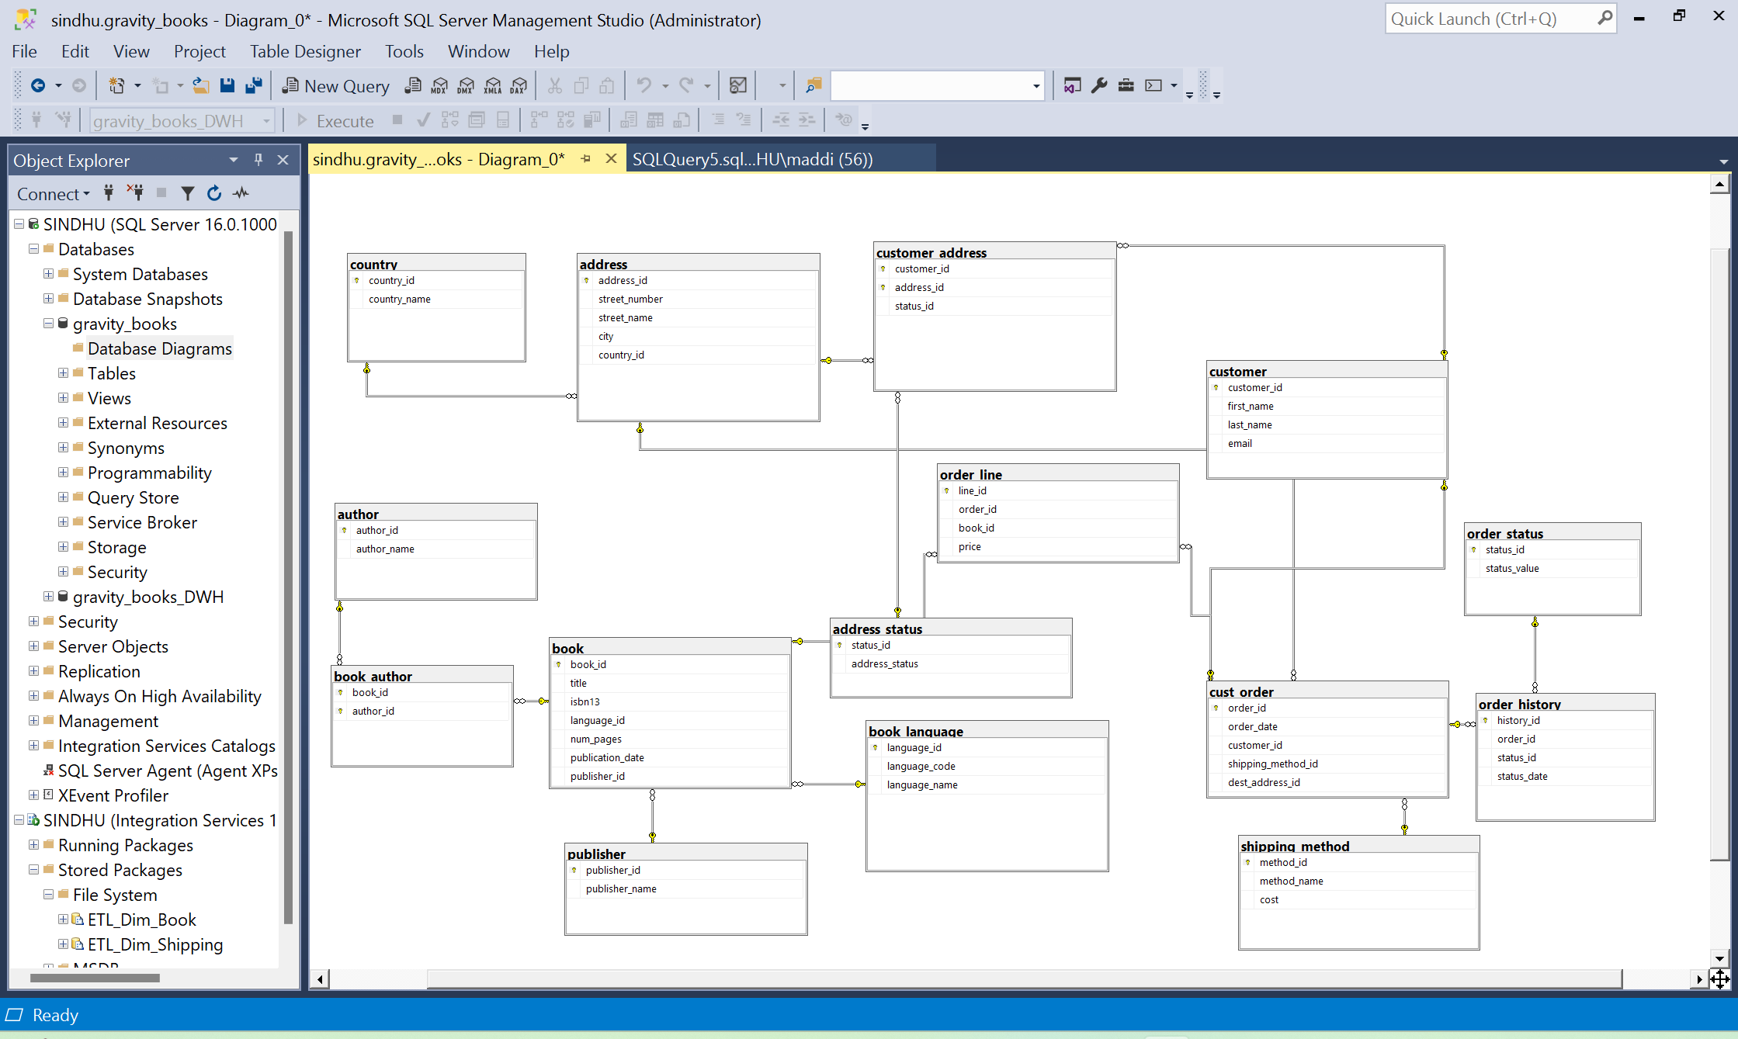
ERD of Gravity_Books_Sales Database
Notes:
This is the ERD diagram for the gravity books database. Here you can see all the tables and their relationship with the others. I will also add a reference for this DB which includes all the necessary sql scripts for populating data at the end.

Slide 16
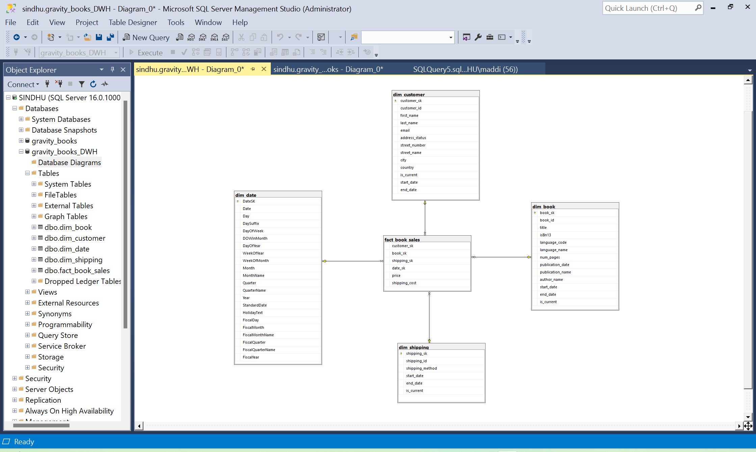
STAR SCHEMA
Notes:
Here what you see is the star schema designed for the gravity books sales DB, you can see the fact table in the center surrounded by the dimension tables as discussed by Benjamin in pervious slides.

Slide 17
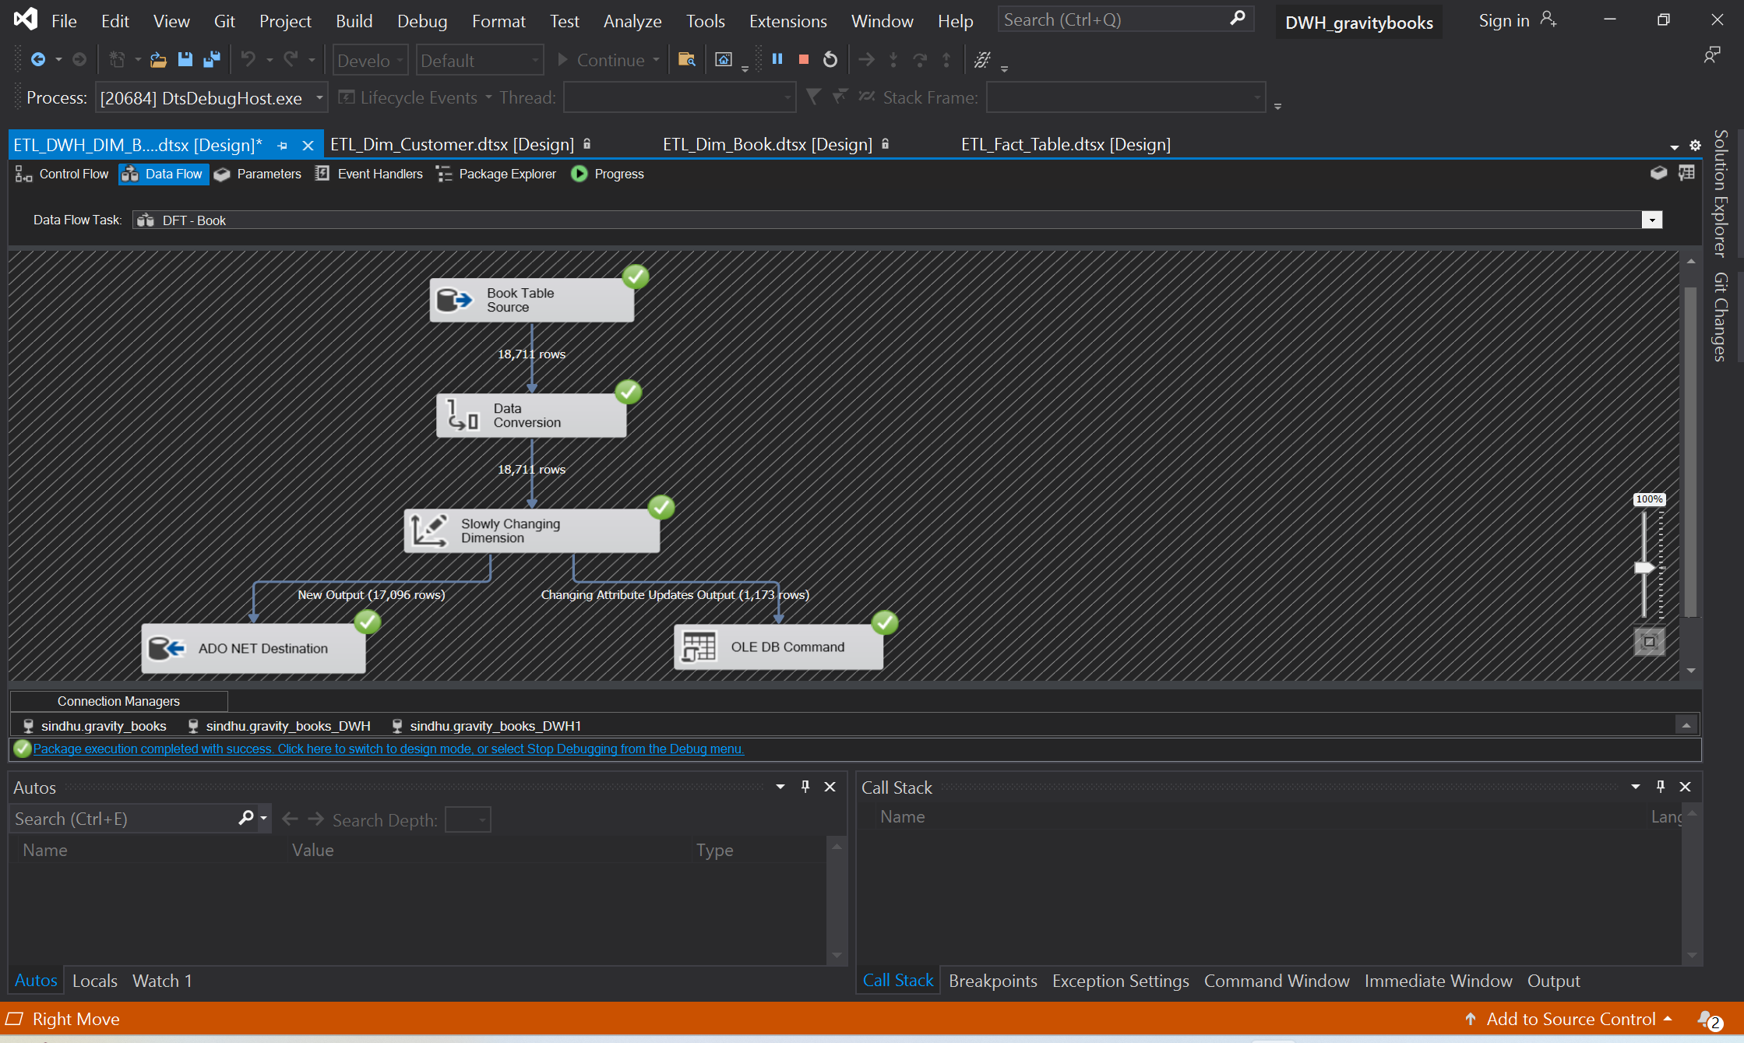
ETL PIPELINE for dim_books table
Notes:
This is a ETL pipeline design for populating book dimension table in the target warehouse, you can see at the top we are extracting data from a data source which is gravity book sales DB here, and then applying some transformations on the extracted data and then finally loading it in the target warehouse.

Slide 18
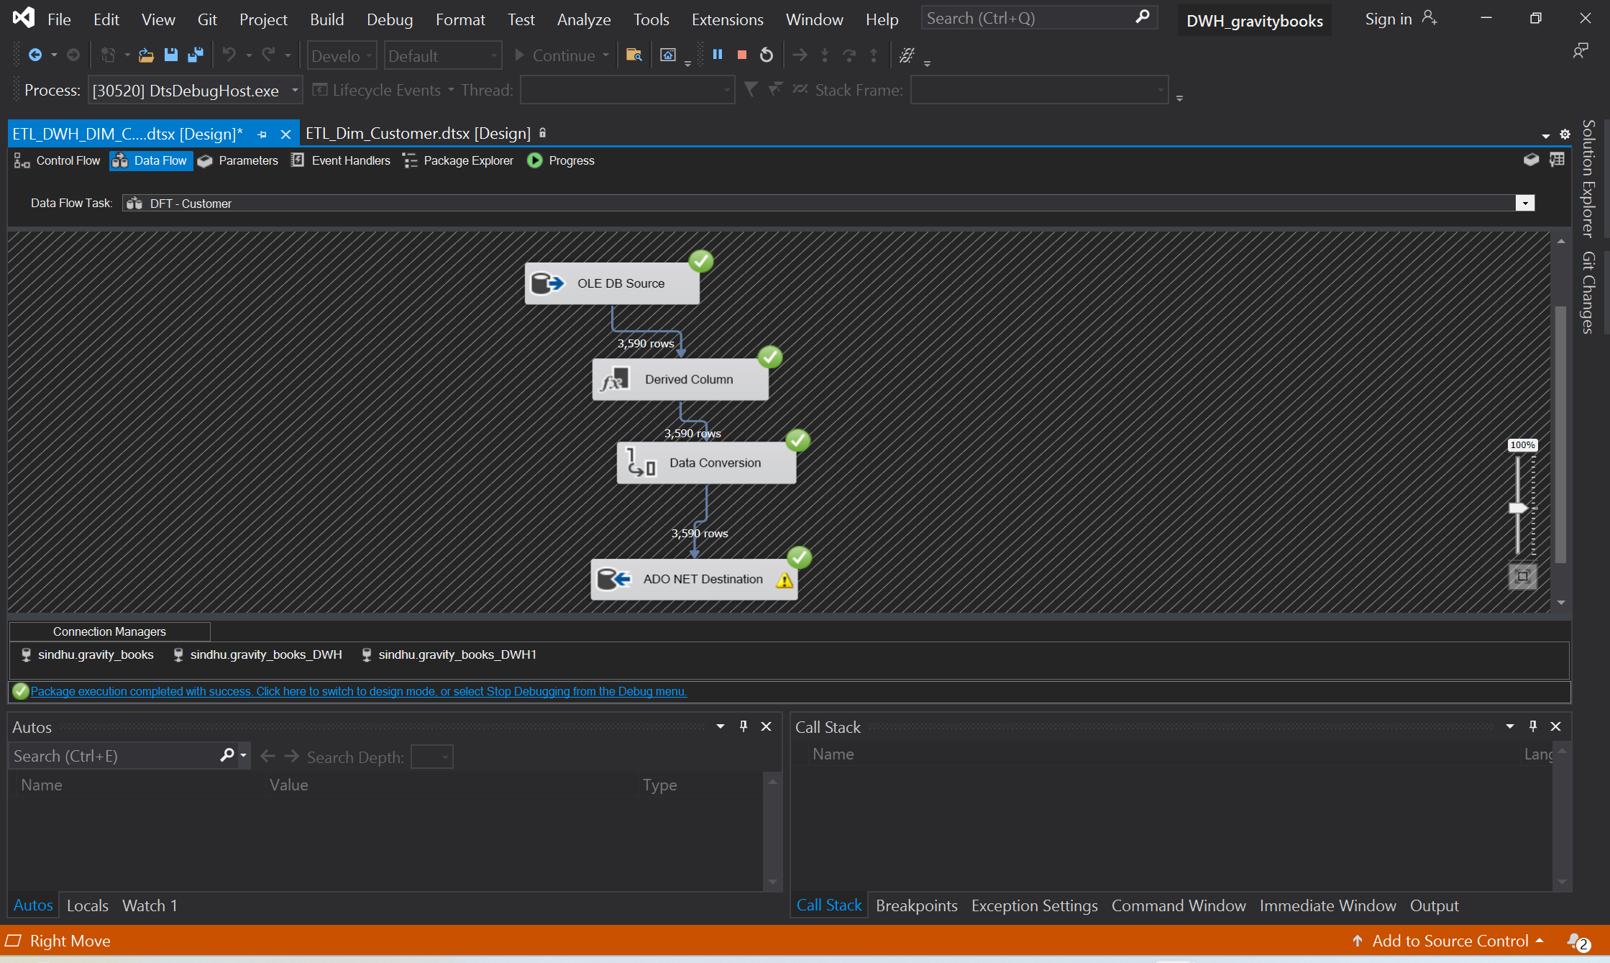
ETL PIPELINE for dim_customer table
Notes:
The process is again same expect that we are doing the pipeline for customer dimension table

Slide 19
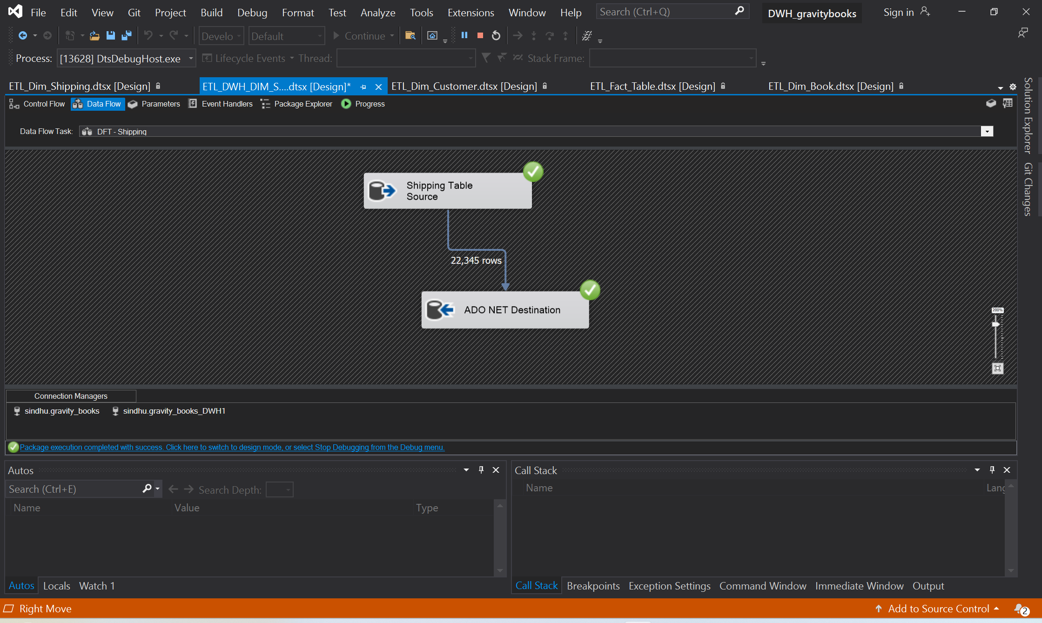
ETL PIPELINE for dim_shipping table
Notes:
Here I thought that the transformation part is not needed, so here I just extracted the data and directly dumped it in the target warehouse by mapping columns and skipping the transformation phase in the pipeline.

Slide 20
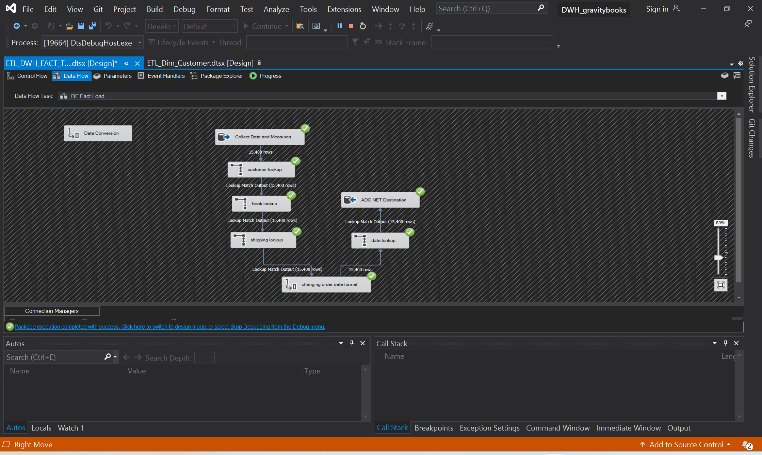
ETL PIPELINE for fact_table
Notes:
And this is the main one, were we extracted data from both gravity book sales database and from the data warehouse itself, and then applied some transformations and then loaded in the Datawarehouse.

Slide 21
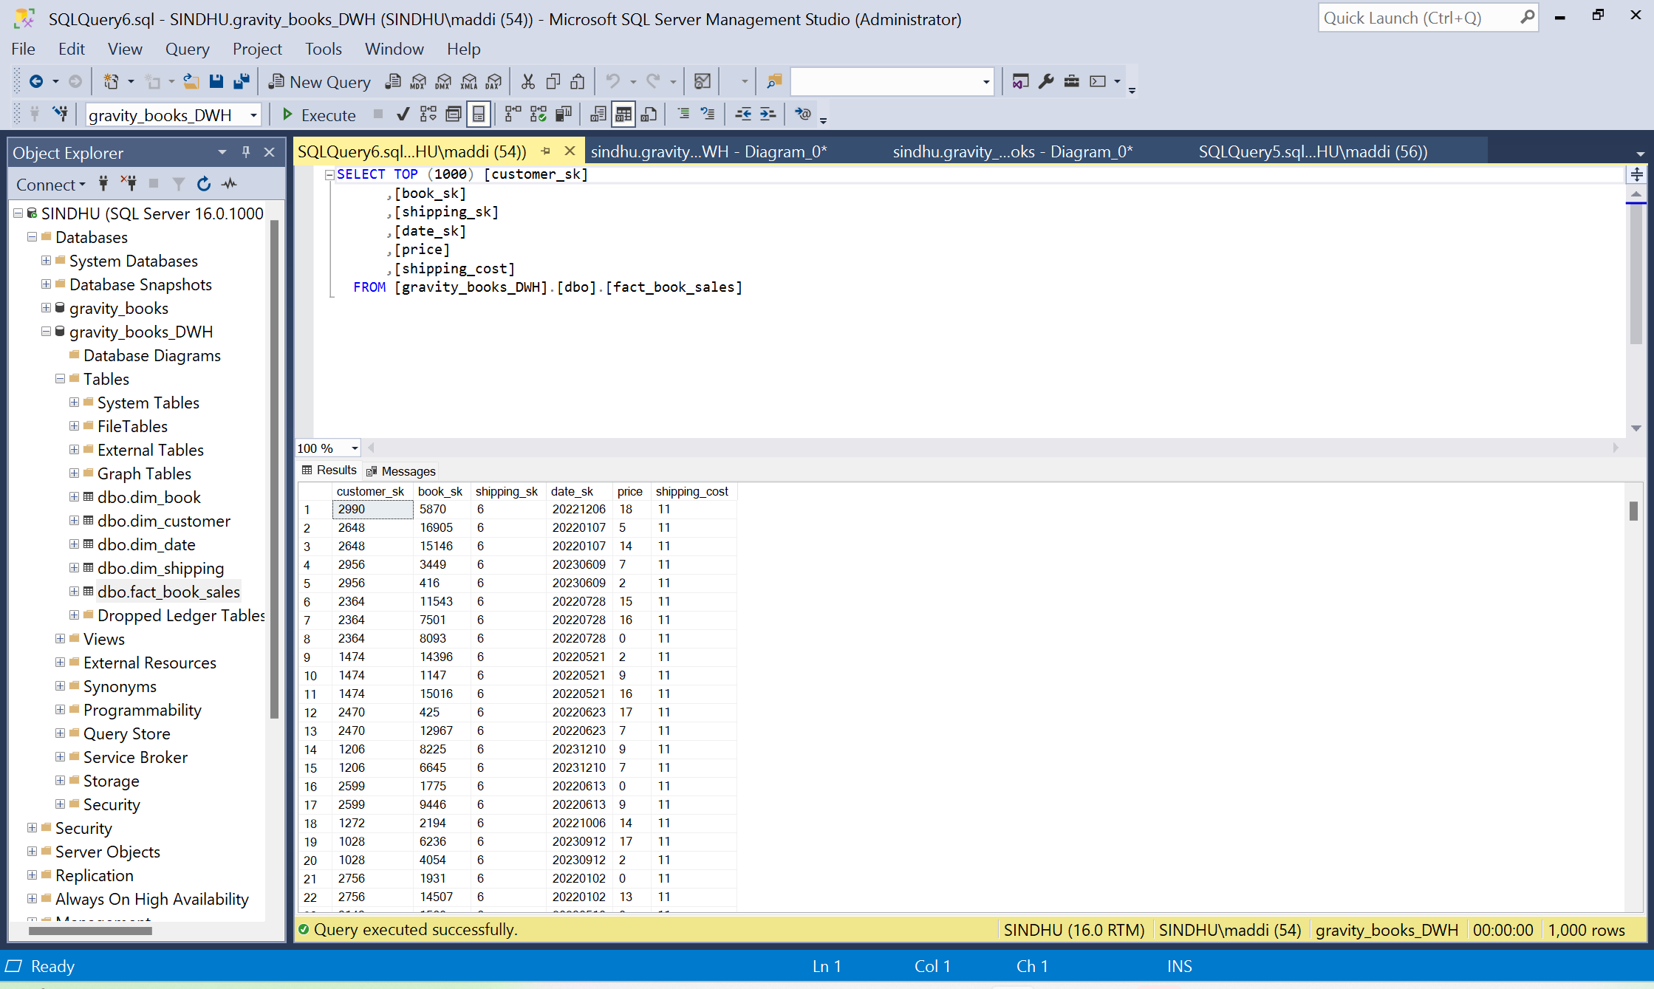
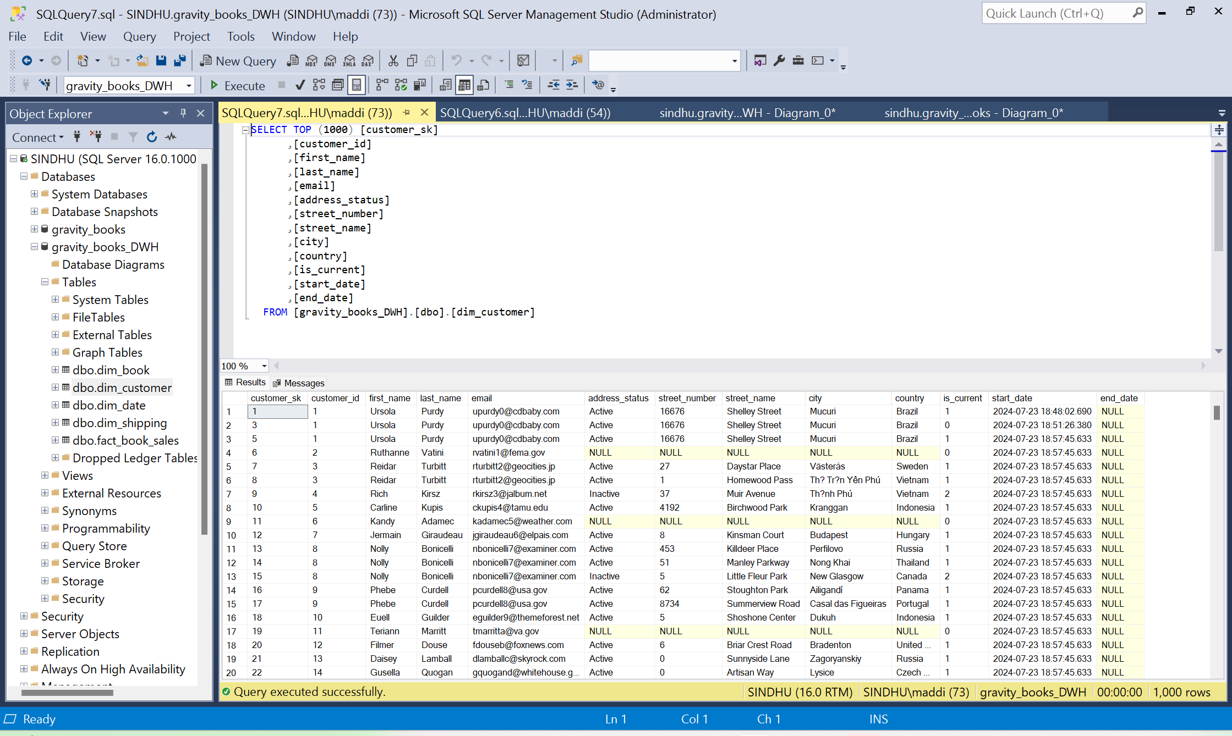
Final Results
Notes:
These are some screen shots of the tables of final Datawarehouse indicating the data is successfully loaded in the target location and showing the pipelines really worked.

